Slide 1
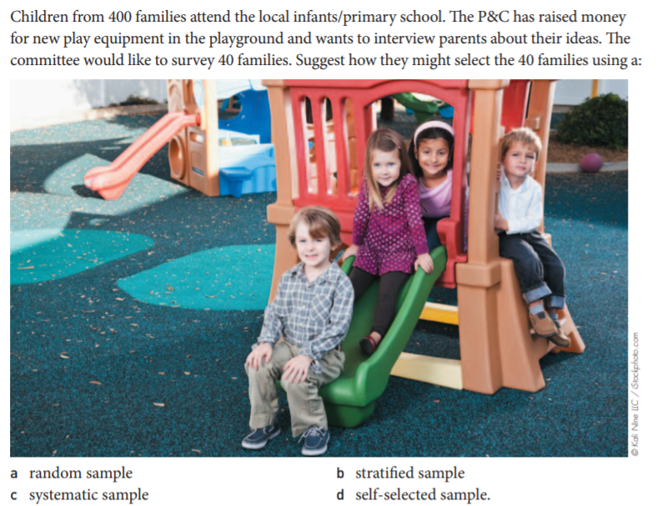
Topic: Census and Surveys EQ: How do we design a survey?
Make sure you are reading through and adding in notes to your EST content list
Hand out task reports
EXIT PASS- in pairs with butcher’s paper

Slide 2
EXIT PASS- in pairs with butcher’s paper

Slide 3
Interested in your reasoning NOT YOUR ANSWER
Complete 3 question Sample or census sheet. You need to give your reasons

Slide 4
Learning Intentions
Students will be able to
Surveys
3.4.3 understand the purpose of sampling to provide an estimate of population values when a census is not used
3.4.4 investigate the different kinds of samples, for example, systematic samples, self‐selected samples, simple random samples
3.4.5 recognise the advantages and disadvantages of these kinds of samples; for example, comparing simple random samples with self‐selected samples

Slide 5
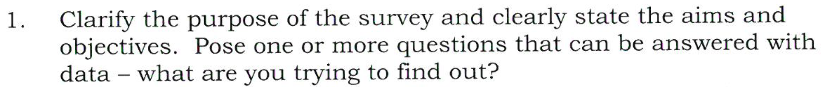
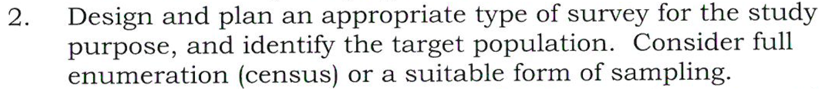
24
7
30
Census & Surveys
Date
EQ – How do we design a Survey?
What is the Statistical Investigation Process?
This is in your manilla folder on the poster

Slide 6
24
7
30
Census & Surveys
Date
EQ – How do we design a Survey?
What is the Statistical Investigation Process?

Slide 7


